Slide 1
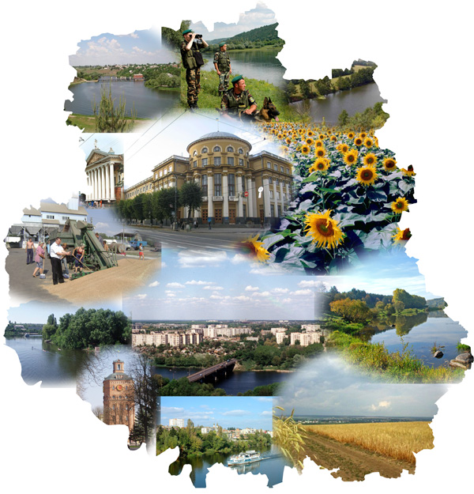
«If you aim to walk fast – walk alone.
If you aim to walk far – walk together!»
Experience of cooperation in partnership
of Vinnytska oblast and CBA Project
Speech of Head of Vinnytska Oblast State Administration
Anatoliy Oliynyk
20 May, 2014

Slide 2
Why Vinnytska oblast cooperates with CBA Project ( 2008 -2014)
COMMUNITIES
CBA PROJECT
LOCAL AUTHORITIES
+
+
Project is a stimulating impetus and motivation for common actions of communities together with authorities;
Project helps to balance burden of maintaining social infrastructure objects in rural area;
Project helps to establish effective partnership between community, local authorities, community organizations and private business sector;
Project develops human resource capacity, indicates and trains new leaders;
Project strengthens community organization and local authorities` capacity for solving current problems and this is the first step towards decentralization of authority;

Slide 3
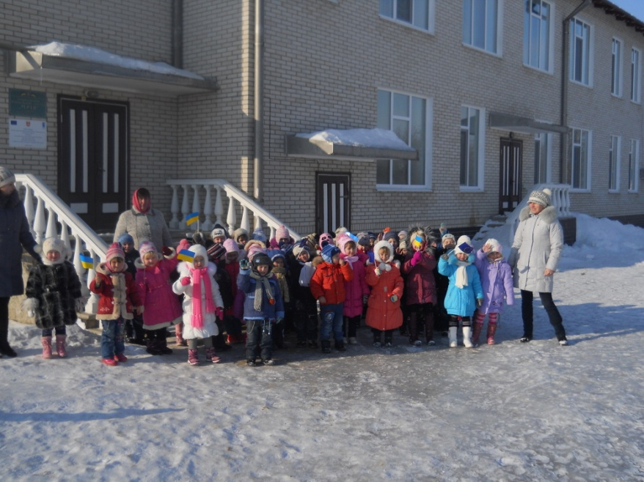
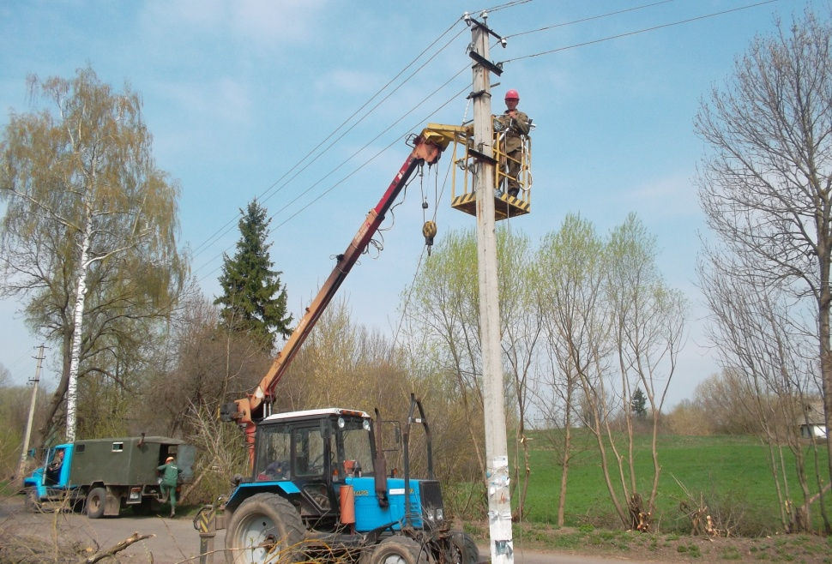
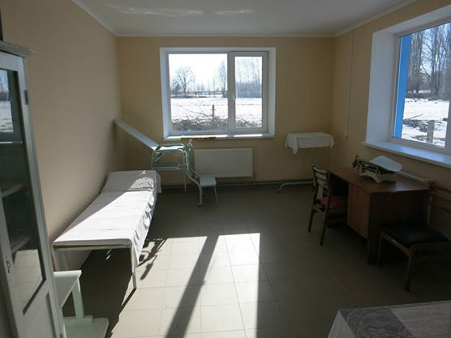
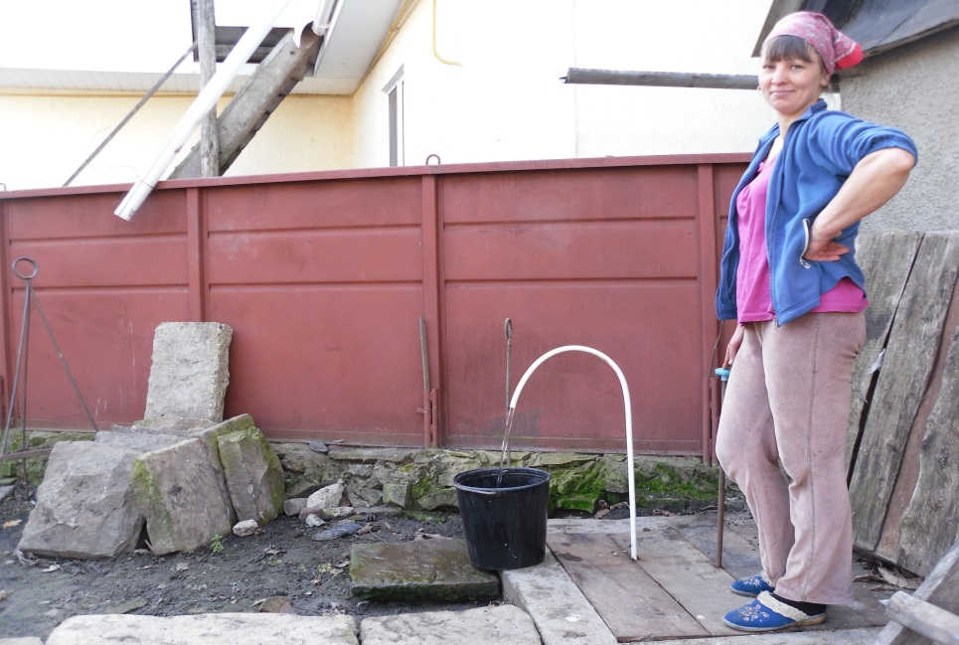
For what Vinnytska oblast is thankful to CBA Project (results of І and ІІ phases)
17 micro-projects on reconstruction of street lighting
38 micro-projects on renovating schools and kindergartens
8 school buses procured
15 micro-projects on reconstruction of local health posts and Community Centers
8 micro-projects on water supply system reconstruction

Slide 4
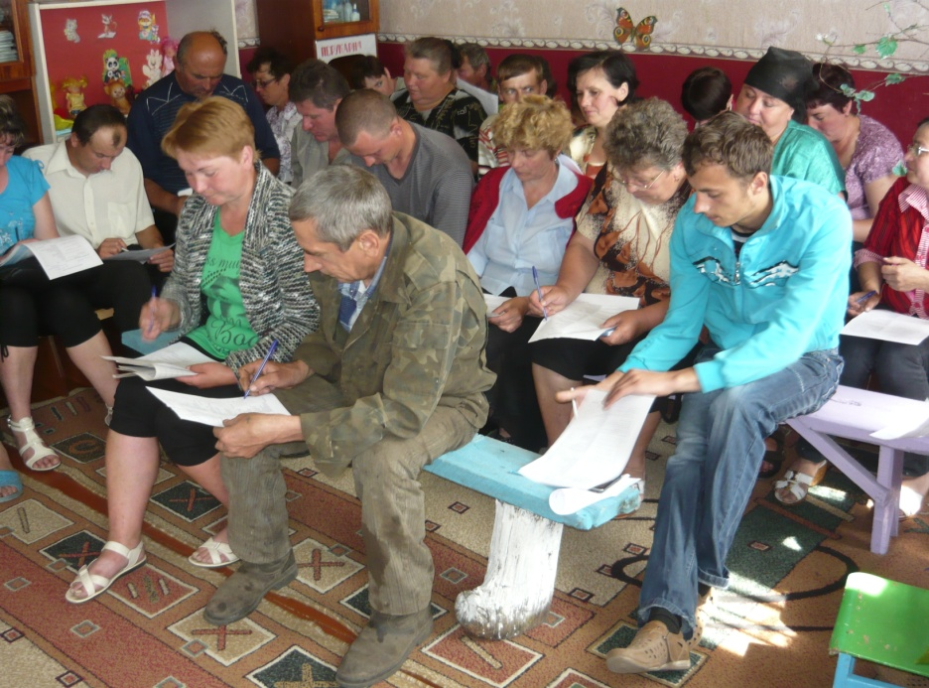
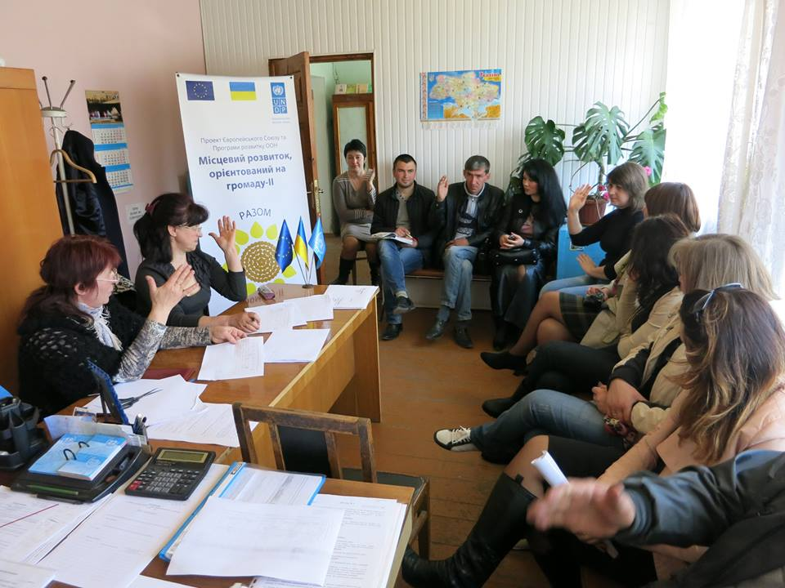
What was the benefit for communities of Vinnytska oblast
Practical experience of decentralized “bottom - up” planning;
Feeling of their own ability to influence on important for community decisions making and implementation process;
Motivation for development and implementation further initiatives, of larger scale and more demanding;
Approaching local communities to European self-government traditions;
Overcoming stereotypes of isolation and remoteness of authorities from the people;
Experience of solving local problems with the help of international donor agencies.

Slide 5
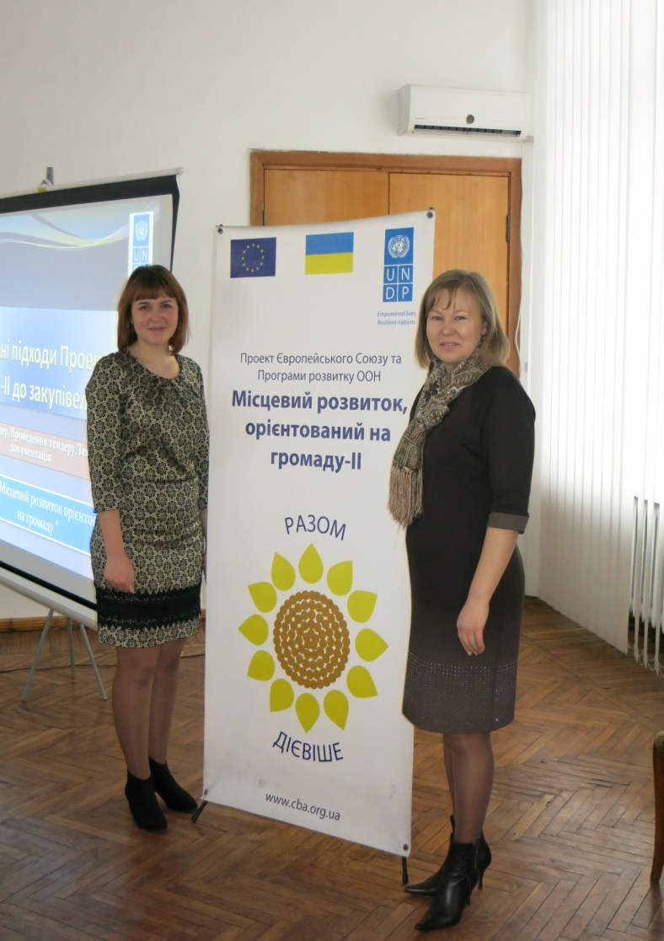
What does Vinnytska oblast expect from further cooperation with CBA
Increased number of pilot communities;
Developing new priorities for co-financing, such as:
tourism industry – “ village green tourist ”;
producing cooperatives;
innovative energy saving measures for social infrastructure;
support for development of e-government in rural area;
computerization and connection to high-speed Internet in village schools;
Increased share of training component of the Project, both for the community and for the authorities;
Development of cultural exchange and sharing of practical experience at national level.

Slide 6
Thank you for your attention!

