Slide 1


Community Based Approach to Local Development – phase 3
Joint project of European Union and United Nations Development Programme
Kiev, May 2014

Slide 2
Overall Objective:
To promote sustainable socio-economic development at local level by strengthening participatory governance and encouraging community-based initiatives throughout Ukraine

Slide 3
CBA –IІІ: 2014-2017
All regions of Ukraine
200 districts
1000 villages and 15 cities
EUR 23.8 mln. (EU: 90%)
1330 micro-projects
1.5 mln. of beneficiaries

Slide 4
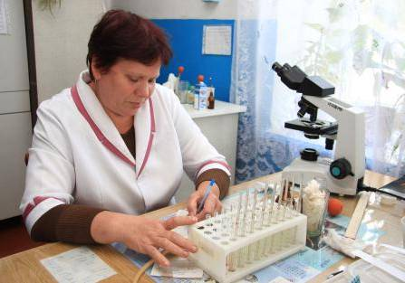

Promoting Community Based Approach to Local Governance
Institutionalization of the approach
Solving of the most acute local problems jointly identified by local communities

Slide 5

Support to Small Economic Initiatives in Rural Communities
Expansion of the support
Institutional development
Access to the information on the modern technologies

Slide 6
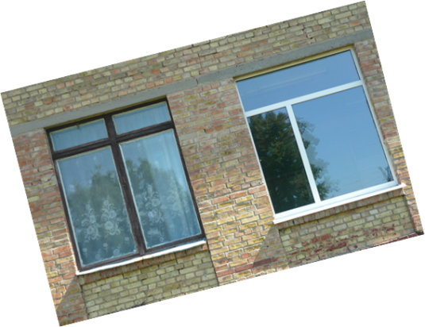

Community-based Approach to Improve Energy Efficiency in Urban Housing
Partnership with municipalities under the population of 150, 000
Energy efficiency as one of the most important priorities
Development of responsible owner
Development of replicable models to solve problems of housing sector

Slide 7
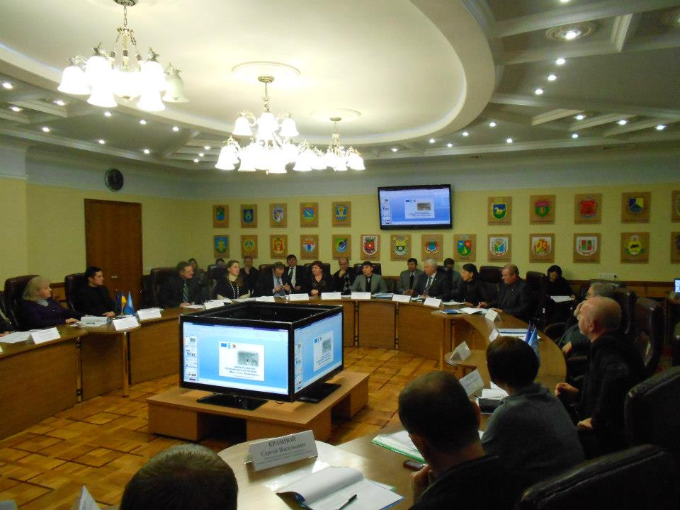
Introduction of Innovation Activities and New Technologies at Local Level
Promotion of e-governance
Opportunities for the municipalities with different level of advancement
Various forms of public engagement as a major priority
Coordination with the national policy

Slide 8
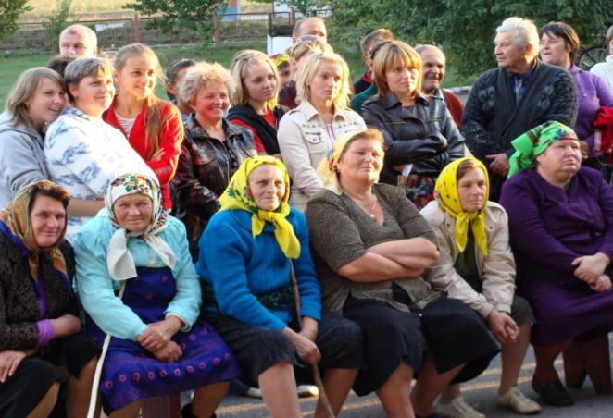
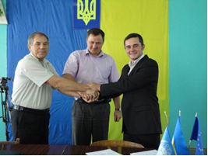
Support to the Decentralization Policy Development and Knowledge Sharing on Sustainable Development
Partnership at the national level, support to the establishment of legal and administrative base
Community development experience as a basis for development of correspondent legal base
Practical support in advancing decentralization
Cooperation with associations

Slide 9
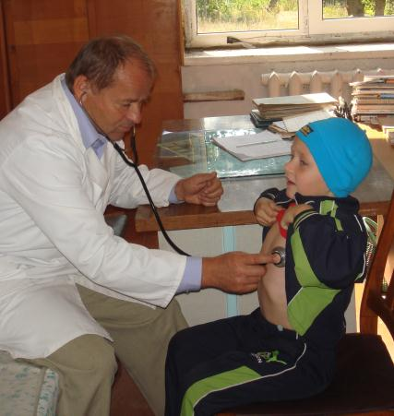
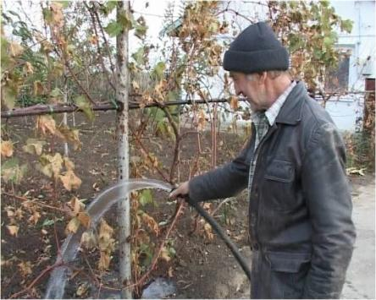
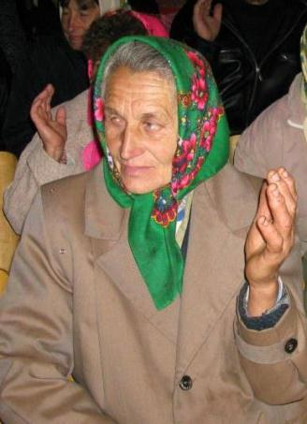
Expected Results
Local communities and local authorities are ready to full fledged implementation of community-led development approach

Slide 10
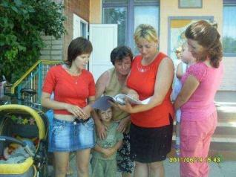
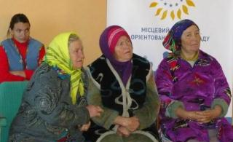
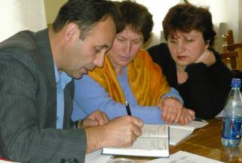

Developed institutional structures supporting joint planning and community initiatives
Improved living conditions in villages and municipalities
Broadening of economic opportunities for rural population
Developed and tested models of management and maintenance of joint property in multi-apartment buildings
Established practices of innovative governance

Slide 11
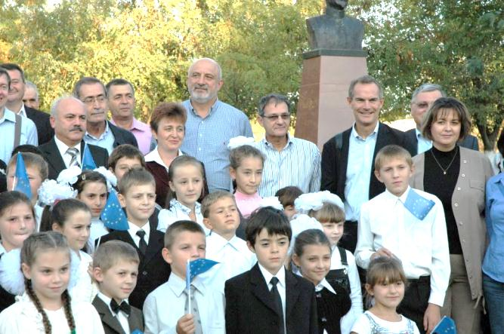
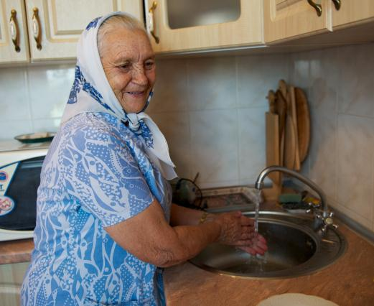
Priorities
 | Villages | Municipalities
1 | Health protection | Support to the establishment of responsible owner of multi apartment buildings Energy efficiency in housing sector
2 | Energy efficiency
3 | Environment | Innovative governance
4 | Water supply
5 | Economic initiative

Slide 12
THANK YOU!
More information: www.cba.org.ua; www.cba.org.ua/three/
Facebook page: http://www.facebook.com/cbaproject

